Slide 1
Finding a length in composite shapes
Perimeter, area and volume

Slide 2
how to use Oak lessons

Slide 3
I can solve area problems of composite shapes involving whole and/or part circles where the area is known and the radius or diameter must be found.

Slide 4
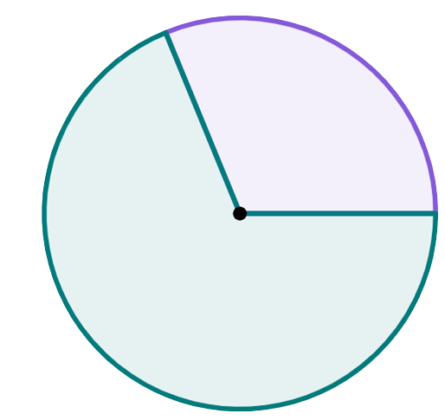
A sector is the region formed between two radii and their connecting arc.
sector
The diameter of a circle is any line segment that starts and ends on the edge of the circle and passes through the centre of the circle.
sector
radius
The radius is any line segment that joins the centre of a circle to its edge.

Slide 5

Finding a length in composite shapes
Finding lengths from areas of circles and sectors
Finding lengths of composite shapes using algebra

Slide 6
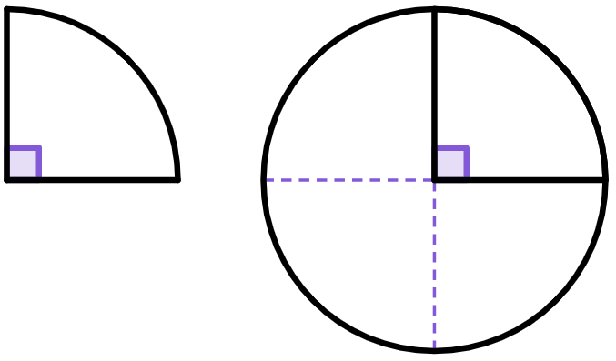
Finding lengths from areas of circles and sectors
The area of this quarter-circle is 9π cm².
How many of these quarter-circles fit into a full circle?
Four quarter-circles fit into a full circle.
Each of these quarter-circles are congruent to the first, and therefore each will have the same area.

Slide 7
Finding lengths from areas of circles and sectors
The area of this quarter-circle is 9π cm².
What is the area of the full circle this sector comes from?
The total area of the full circle is:
9π + 9π + 9π + 9π
= 9π × 4
= 36π cm²
9π
9π
9π
9π
You need 4 quarter-circles to create one full circle.
Each of these quarter-circles are congruent to the first, and therefore each will have the same area.

Slide 8
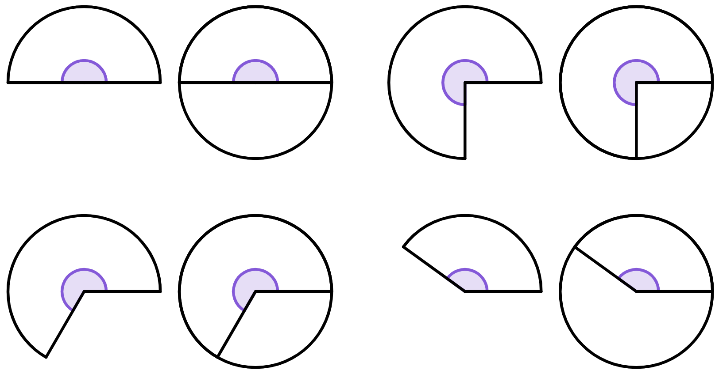
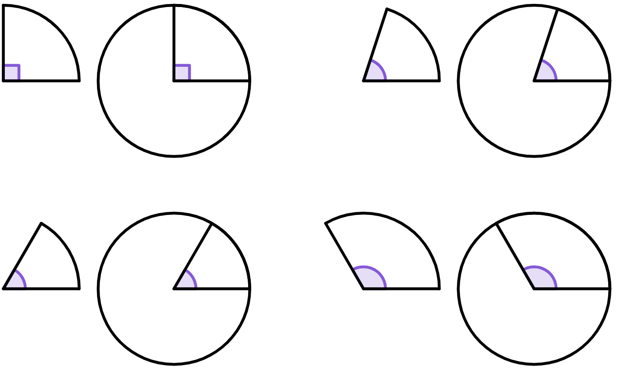
Finding lengths from areas of circles and sectors
The area of this three-quarter-circle is 27π cm².
What is the area of the full circle this sector comes from?
We can divide the 27π across each of three quarter-circles.
27π ÷ 3 = 9π
If each quarter circle has an area of 9π, then the full circle has an area of
9π
9π
9π
9π
9π
9π
9π
9π × 4
= 36π cm²
This is different, we can’t fit a multiple of these sectors into a full circle.
There are still four quarter-circles in a full circle.
But, we can split the shape up into three quarter-circles.

Slide 9
Finding lengths from areas of circles and sectors
The area of this three-quarter-circle is 27π cm².
What is the area of the full circle this sector comes from?
9π
9π
9π
9π
9π
÷ 3
× 4
9π
9π
9π
area of
27π
area of
9π
area of
36π

Slide 10
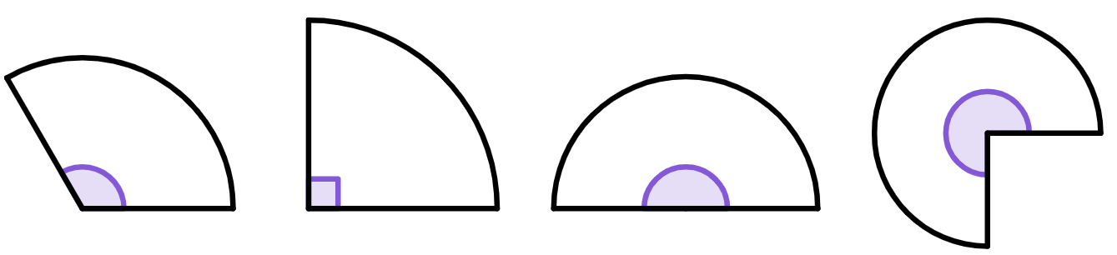

Finding lengths from areas of circles and sectors
Each of these sectors has the same area of 18π.
Match the sector to the calculation to find the area of the full circle that the sector comes from, and the value of the area of the full circle.
1
2
3
4
a
18π × 2
c
18π × 4
e
72π cm²
g
24π cm²
b
18π × 3
d
18π × 4 ÷ 3
f
113 cm²
h
169.6 cm²

Slide 11
Finding lengths from areas of circles and sectors
Each of these sectors has the same area of 18π.
Match the sector to the calculation to find the area of the full circle that the sector comes from, and the value of the area of the full circle.
1
2
3
4
b
18π × 3
c
18π × 4
a
18π × 2
113 cm²
d
18π × 4 ÷ 3
h
169.6 cm²
e
72π cm²
f
g
24π cm²

Slide 12

Finding lengths from areas of circles and sectors
Find the area of this circle.
Find the area of this circle, giving your answer both in terms of π and rounded to 1 decimal place.
6 cm
10 cm
area = π × r²
= π × 6²
We can either leave the area in terms of π, or use a calculator to convert it into a decimal.
area = π × r²
= 36π cm²
You do.
= π × 10²
= 113.097…
= 100π cm²
≈ 113 cm²
= 314.159…
≈ 314.2 cm²

Slide 13

Finding lengths from areas of circles and sectors
The area of this circle is 254.5 mm².
Find its radius, r.
Give your answer to the nearest integer.
The area of this circle is 78.5 inches².
Find its radius, r.
Give your answer to the nearest integer.
r
r
area = π × r²
78.5 = π × r²
254.5 = π × r²
π
π
π
π
You do.
24.98… = r²
81.00… = r²
5 ≈ r
9 ≈ r
The radius is 5 inches (1 s.f.).
The radius is 9 mm (to 1 s.f.).

Slide 14
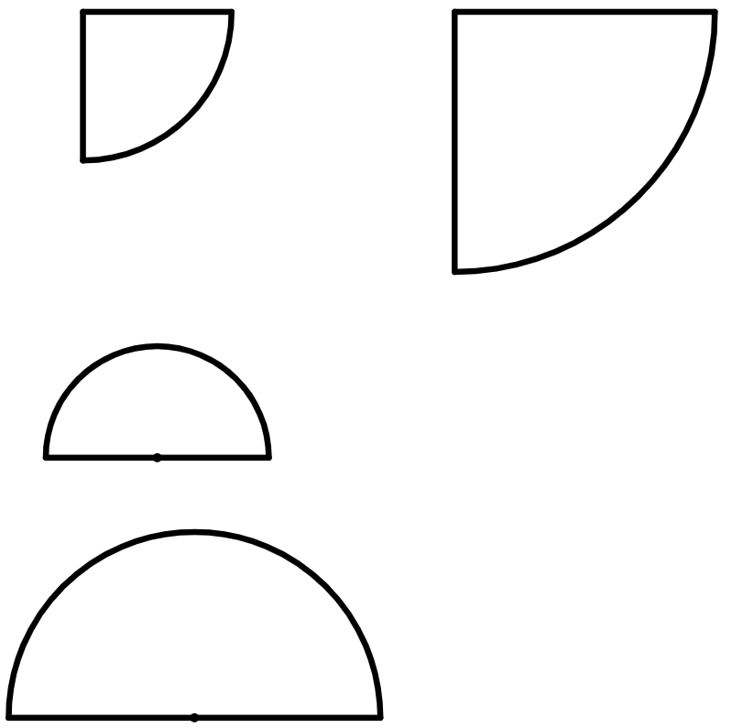
Finding lengths from areas of circles and sectors
The area of this quarter-circle is 25π cm².
Find the radius of this quarter-circle.
Step 1: Find the area of the full circle that this sector comes from.
area of quarter-circle = 25π
area of full circle = 100π
Step 2: Find the radius using the area of the full circle from step 1.
25π
25π
area of full circle = π × r²
10 cm
the radius of this quarter-circle is 10 cm
100π = π × r²
25π
25π
π
π
100 = r²
total area = 100π
10 = r

Slide 15
Finding lengths from areas of circles and sectors
1) Complete the table to find the area of the full circle that the sector comes from.
area of sector | 10π cm² | 25.1 cm² | 31π cm² | 60π cm²
calculation | 10π × 4 | 25.1 × 2
area of full circle | 40π cm²

Slide 16
Finding lengths from areas of circles and sectors
2) The area of this quarter-circle is 900π cm².
a) Find the area of the full circle that the sector comes from.
b) Using your answer to part a, complete the method to calculate the radius of this quarter-circle.
area of full circle = π × r²
= π × r²
= r²
60 cm = r

Slide 17
Finding lengths from areas of circles and sectors
3) The area of a semicircle is 39.3 cm².
Complete the method to calculate the diameter of this semicircle.
4) The area of this three-quarter-circle is 1357.2 cm².
What is the radius of the sector?
area of full circle = π × r²
= π × r²
= r²
= r
d
= d

Slide 18
Finding lengths from areas of circles and sectors
1) Complete the table to find the area of the full circle that the sector comes from.
area of sector | 10π cm² | 25.1 cm² | 31π cm² | 60π cm²
calculation | 10π × 4 | 25.1 × 2 | 31π × 4 | 60π ÷ 3 × 4
area of full circle | 40π cm² | 50.2 cm² | 124π cm² | 80π cm²

Slide 19
Finding lengths from areas of circles and sectors
2) The area of this quarter-circle is 900π cm².
a) Find the area of the full circle that the sector comes from.
area of full circle = 3600π
b) Using your answer to part a, complete the method to calculate the radius of this quarter-circle.
area of full circle = π × r²
3600π
= π × r²
3600
= r²
60 cm = r

Slide 20
Finding lengths from areas of circles and sectors
3) The area of a semicircle is 39.3 cm².
Complete the method to calculate the diameter of this semicircle.
4) The area of this three-quarter-circle is 1357.2 cm².
What is the radius of the sector?
area of full circle = π × r²
78.6
= π × r²
25.01…
= r²
5.001…
= r
d
area of quarter-circle = 452.4
area of full circle = 1809.6
r = 24 cm (2 s.f.)
10 cm
≈ d

Slide 21
Finding a length in composite shapes
Finding lengths from areas of circles and sectors
Finding lengths of composite shapes using algebra

Slide 22
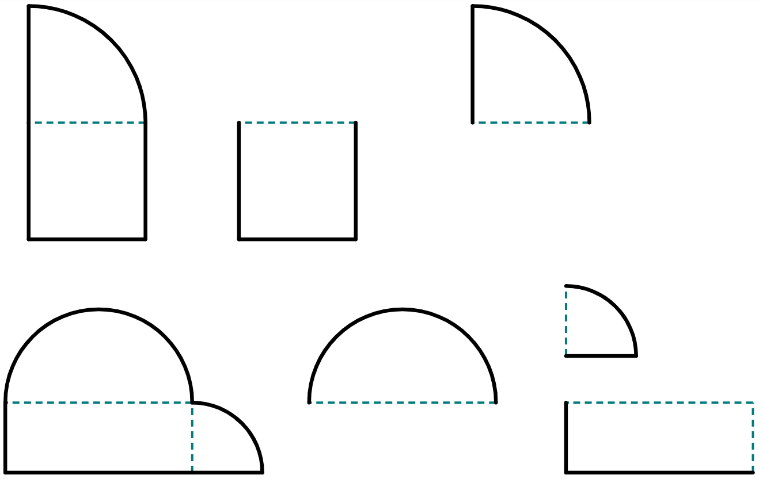
Finding lengths of composite shapes using algebra
In order to find the lengths in a composite shape involving sectors of a circle, we will look at two techniques you could use depending on the shape:
break a composite shape into its component parts
rearrange the component parts of a shape to make shapes whose areas are easier to deal with

Slide 23
Finding lengths of composite shapes using algebra
You can break a composite shape up into its component parts if you can spot that it is made from many different rectangles, sectors, etc.
r
r
If this radius is r
r
This shape has an area of 1606.9 cm²

Slide 24
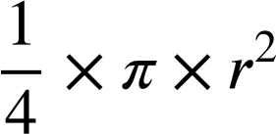
Finding lengths of composite shapes using algebra
You can break a composite shape up into its component parts if you can spot that it is made from many different rectangles, sectors, etc.
r
r
r
r
This is a quarter-circle with a radius of r.
This is a square with sides of length r.
This shape has an area of 1606.9 cm²
area =
area =
area =

Slide 25
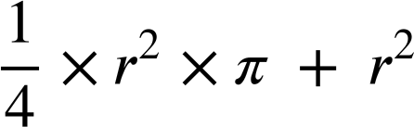
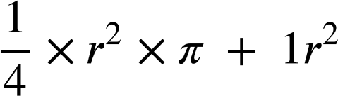
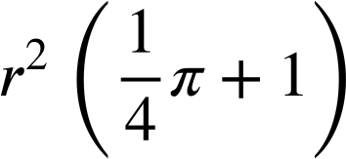
Finding lengths of composite shapes using algebra
The total area of this composite shape can be written as an equation, with the algebraic representation on one side, and the numerical on the other:
= 1606.9
In order to solve this equation, we need to factorise r² out of the left expression.
To help, we can treat the r² term as 1r².
square
quarter-circle
= 1606.9
= 1606.9
This shape has an area of 1606.9 cm²

Slide 26
Finding lengths of composite shapes using algebra
The total area of this composite shape can be written as an equation, with the algebraic representation on one side, and the numerical on the other:
= 1606.9
The expression inside the bracket is just a number.
Type this into your calculator to get:
= 1606.9
= 1606.9
This shape has an area of 1606.9 cm²
× 1.785…
= 1606.9
1.785…
1.785…
r² = 900.02...

Slide 27
Finding lengths of composite shapes using algebra
The total area of this composite shape can be written as an equation, with the algebraic representation on one side, and the numerical on the other:
r² = 900.02
...
r = 30 cm (2 s.f.)
This shape has an area of 1606.9 cm²

Slide 28
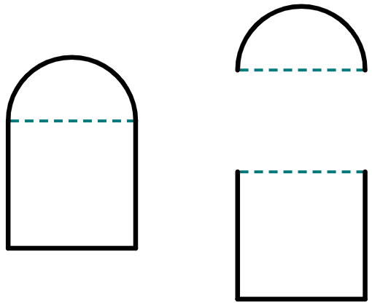
Finding lengths of composite shapes using algebra
Which of these expressions represents the area of the semicircle (1) and which the square (2)?
1
r cm
a
2
2r cm
2
b
c
This shape has an area of 200.5 cm²
d
1
e

Slide 29
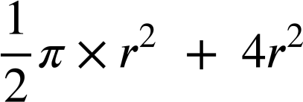
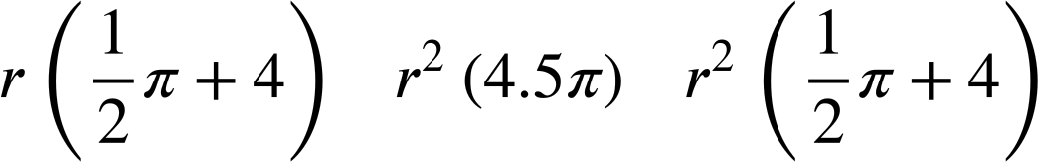

Finding lengths of composite shapes using algebra
The area of this composite shape is
r cm
Which of these expressions is the correctly fully factorised form of the area?
2r cm
a
This shape has an area of 200.5 cm²
b
c

Slide 30
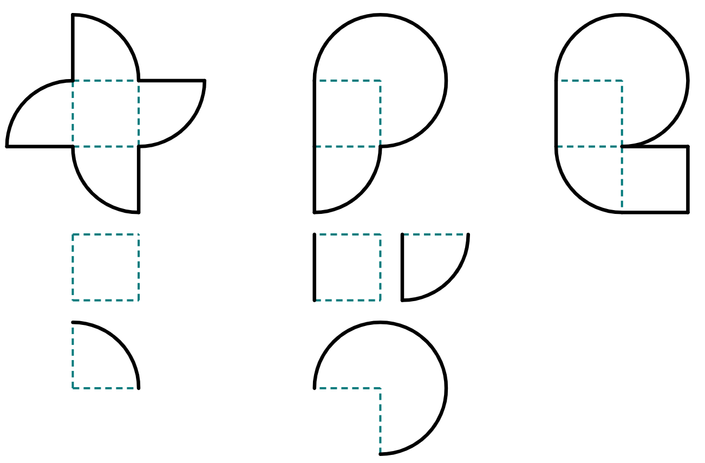
Finding lengths of composite shapes using algebra
You can rearrange the component parts of a shape if it is possible to make more complete shapes, such as full circles.
These are the component parts of this composite shape.
These two parts rearrange to create a full circle.
This shape has an area of 202.9 cm²

Slide 31
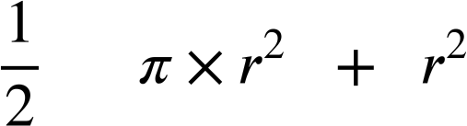
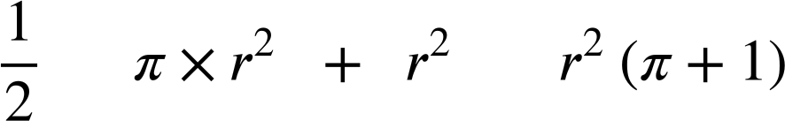
Finding lengths of composite shapes using algebra
You can rearrange the component parts of a shape if it is possible to make more complete shapes, such as full circles.
r cm
The area of this composite shape is:
= 202.9
circle
square
= 202.9
r cm
× 4.141…
= 202.9
This shape has an area of 202.9 cm²
= 48.990…
≈ 7 cm

Slide 32
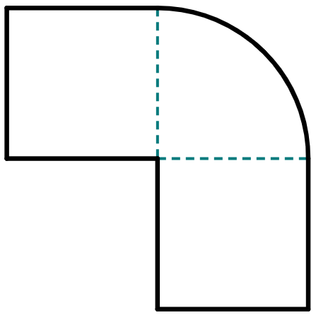
Finding lengths of composite shapes using algebra
1) This composite shape has an area of 470.7 m².
a) Write down the areas, in terms of r, for the three component parts of this shape.
1
3
area of
1
area of
2
2
area of
3
r m
b) Show by factorising that the area of the composite shape can be written as:
× 2.785…

Slide 33
Finding lengths of composite shapes using algebra
1) This composite shape has an area of 470.7 m².
c) Complete the calculation to find the radius of the quarter-circle, given to the nearest integer.
1
3
× 2.785…
= 470.7
2
r m

Slide 34
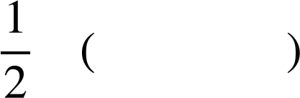
Finding lengths of composite shapes using algebra
2) This composite shape has an area of 11 633.7 mm².
Complete the steps to calculate the value of r, giving your answer to the closest integer.
area:
= 11 633.7
circle
square
factorise:
= 11 633.7
r mm
convert π expression into decimal:
= 11 633.7
divide:
=
square root:
=

Slide 35
Finding lengths of composite shapes using algebra
3) This composite shape has an area of 4031 cm².
Find the value of r, giving your answer to the closest integer.
r cm

Slide 36
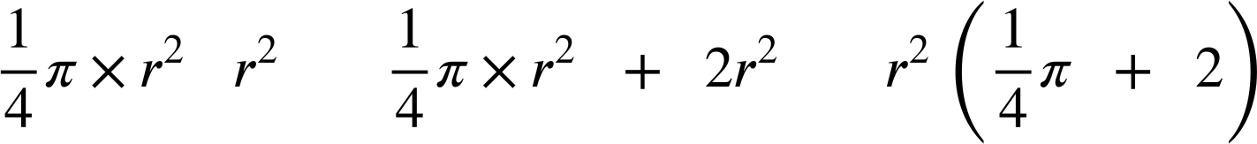
Finding lengths of composite shapes using algebra
1) This composite shape has an area of 470.7 m².
a) Write down the areas, in terms of r, for the three component parts of this shape.
1
3
area of
1
area of
3
2
area of
2
r m
b) Show by factorising that the area of the composite shape can be written as:
=
=
× 2.785…

Slide 37
Finding lengths of composite shapes using algebra
1) This composite shape has an area of 470.7 m².
c) Complete the calculation to find the radius of the quarter-circle, given to the nearest integer.
1
3
× 2.785…
= 470.7
= 169
2
= 13 m
r m

Slide 38
Finding lengths of composite shapes using algebra
2) This composite shape has an area of 11 633.7 mm².
Complete the steps to calculate the value of r, giving your answer to the closest integer.
area:
= 11 633.7
circle
square
factorise:
= 11 633.7
r mm
convert π expression into decimal:
4.14…
= 11 633.7
=
divide:
2808.99…
≈
square root:
53 mm

Slide 39
Finding lengths of composite shapes using algebra
3) This composite shape has an area of 4031 cm².
Find the value of r, giving your answer to the closest integer.
2r² + 𝜋r² = 4031
r = 28 cm (0 d.p.)
r cm

Slide 40
Finding a length in composite shapes
Finding the radius or diameter of a sector of a circle (such as a semicircle or quarter-circle) can be made easier by first finding the area of the full circle that the sector comes from.
The radius of a sector can be found by solving an algebraic equation that equates an algebraic and numerical representation of the area of the sector.
Lengths of a composite shape can be found by either:
solving an algebraic equation that equates an algebraic and numerical representation of the area
comparing the π terms and/or non-π terms of the algebraic and numerical representations of the area

Slide 41

© Oak National Academy 2023.
Produced in partnership with Mathematics in Education and Industry.
Licensed on the Open Government Licence v3.0, except where otherwise stated. See Oak terms and conditions.

